Slide 1
Оптический поток, трекинг

Slide 2
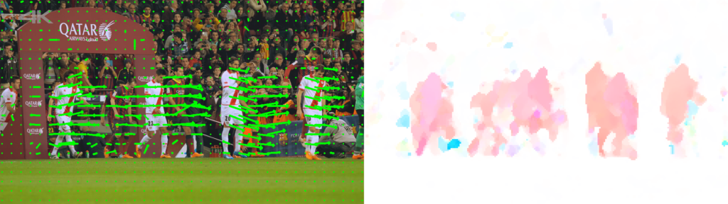
Оптический поток

Slide 3
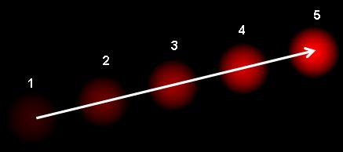
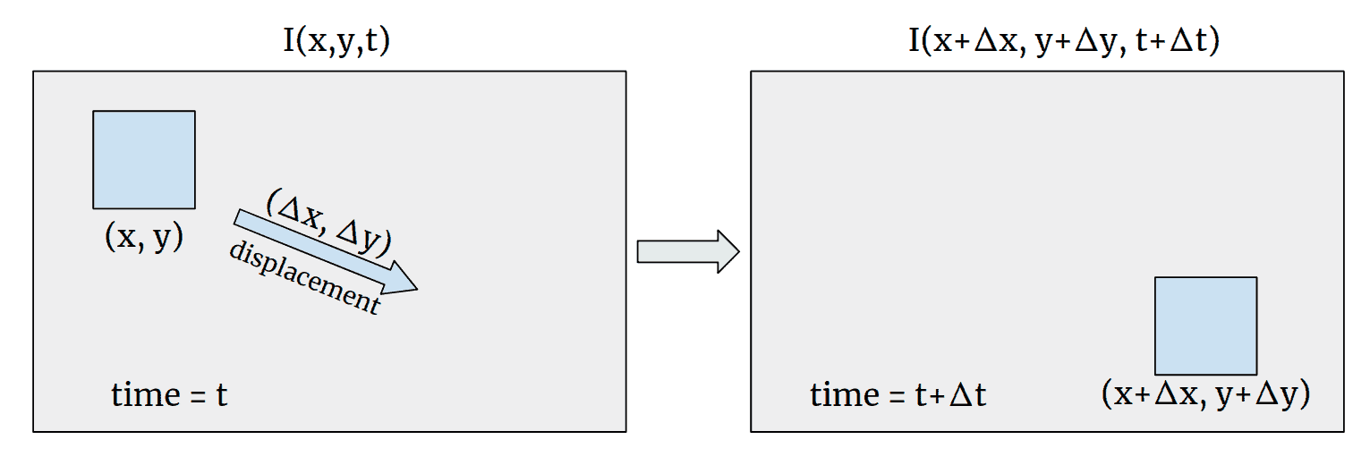



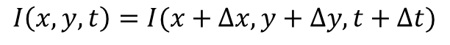
Оптический поток
$$I\left(x,y,t\right)=I(x+∆x,y+∆y,t+∆t)$$
$I\left(x+∆x,y+∆y,t+∆t\right)=I\left(x,y,t\right)+\frac{∂I}{∂x}∆x+\frac{∂I}{∂y}∆y+\frac{∂I}{∂t}∆t+$ higher-order terms
$$\frac{∂I}{∂x}∆x+\frac{∂I}{∂y}∆y+\frac{∂I}{∂t}∆t=0$$
$$\frac{∂I}{∂x}\frac{∆x}{∆t}+\frac{∂I}{∂y}\frac{∆y}{∆t}+\frac{∂I}{∂t}\frac{∆t}{∆t}=0$$
Подробное объяснение
$$\frac{∂I}{∂x}V_{x}+\frac{∂I}{∂y}V_{y}+\frac{∂I}{∂t}=0$$
$$I_{x}V_{x}+I_{y}V_{y}=−I_{t}$$
$$∇I∙\vec{V}=−I_{t}$$

Slide 4
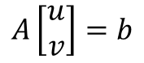
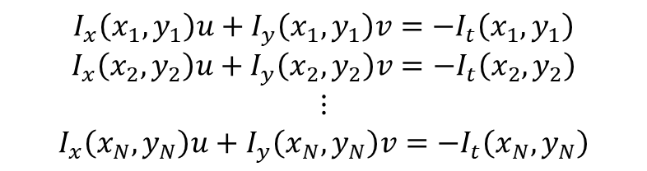
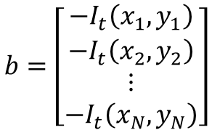

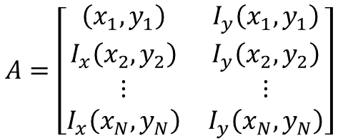
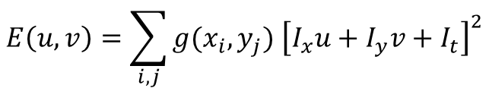
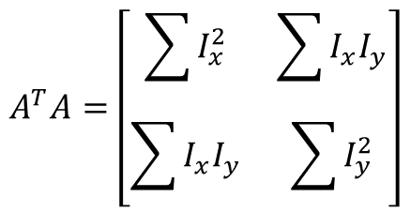
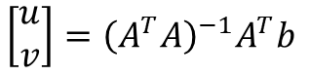
Оптический поток, Lucas–Kanade method
$$I_{x}V_{x}+I_{y}V_{y}=−I_{t}$$
$$I_{x}\left(x_{1},y_{1}\right)u+I_{y}\left(x_{1},y_{1}\right)v=−I_{t}\left(x_{1},y_{1}\right)$$
$$I_{x}\left(x_{2},y_{2}\right)u+I_{y}\left(x_{2},y_{2}\right)v=−I_{t}\left(x_{2},y_{2}\right)$$
$$⋮$$
$$I_{x}\left(x_{N},y_{N}\right)u+I_{y}\left(x_{N},y_{N}\right)v=−I_{t}\left(x_{N},y_{N}\right)$$
$\left(x_{1},y_{1}\right)$,$\left(x_{2},y_{2}\right),…,\left(x_{N},y_{N}\right)−$ пиксели внутри окна
$$A\left[\begin{matrix}u \\ v\end{matrix}\right]=b$$
$$A=\left[\begin{matrix}\left(x_{1},y_{1}\right) & I_{y}\left(x_{1},y_{1}\right) \\ I_{x}\left(x_{2},y_{2}\right) & I_{y}\left(x_{2},y_{2}\right) \\ ⋮ & ⋮ \\ I_{x}\left(x_{N},y_{N}\right) & I_{y}\left(x_{N},y_{N}\right)\end{matrix}\right]$$
$$b=\left[\begin{matrix}{−I}_{t}\left(x_{1},y_{1}\right) \\ {−I}_{t}\left(x_{2},y_{2}\right) \\ ⋮ \\ {−I}_{t}\left(x_{N},y_{N}\right)\end{matrix}\right]$$
$$E\left(u,v\right)=\sum_{i,j}{g(x_{i},y_{j}) {\left[I_{x}u+I_{y}v+I_{t}\right]}^{2}}$$
$$A^{T}A=\left[\begin{matrix}\sum{I_{x}^{2}} & \sum{I_{x}I_{y}} \\ \sum{I_{x}I_{y}} & \sum{I_{y}^{2}}\end{matrix}\right]$$
$$\left[\begin{matrix}u \\ v\end{matrix}\right]={\left(A^{T}A\right)}^{−1}A^{T}b$$

Slide 5
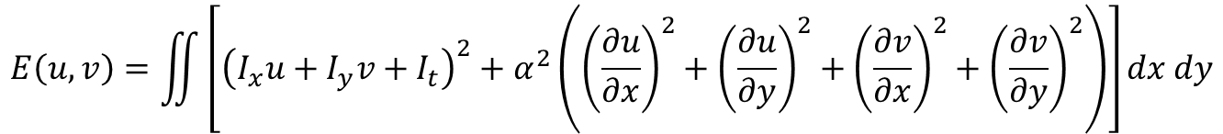
Оптический поток, Horn–Schunck method
$$I_{x}V_{x}+I_{y}V_{y}=−I_{t}$$
добавление условия гладкости
(сумма квадратов производных)
$$E\left(u,v\right)=\iint{\left[{\left(I_{x}u+I_{y}v+I_{t}\right)}^{2}+α^{2}\left({\left(\frac{∂u}{∂x}\right)}^{2}+{\left(\frac{∂u}{∂y}\right)}^{2}+{\left(\frac{∂v}{∂x}\right)}^{2}+{\left(\frac{∂v}{∂y}\right)}^{2}\right)\right]dx dy}$$
+ Farneback method (аппроксимация локальной окрестности изображения второй степенью полинома)

Slide 6
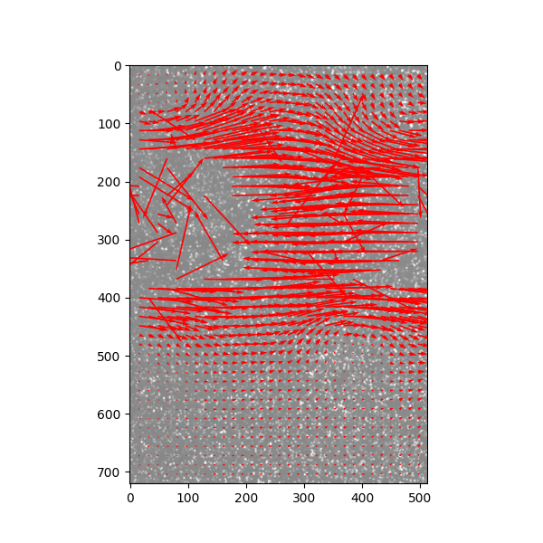
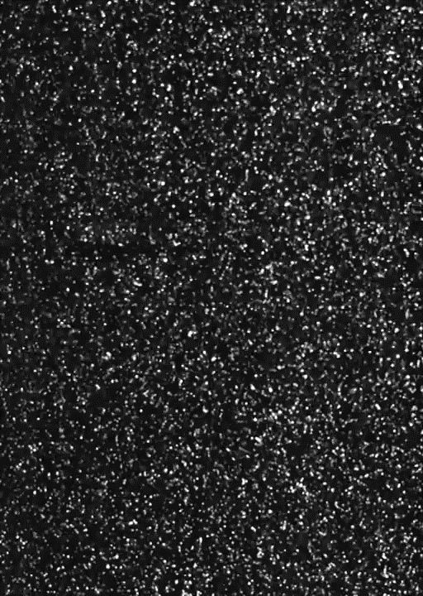
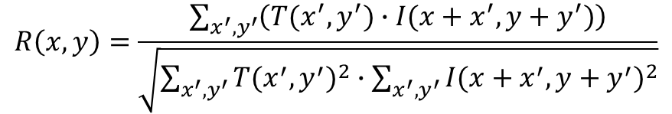
Particle image velocimetry (PIV)
Кросс-корреляция
$$R\left(x,y\right)=\frac{\sum_{x^{′},y^{′}}{\left(T(x^{′},y^{′})∙I(x+x^{′},y+y^{′})\right)}}{\sqrt{\sum_{x^{′},y^{′}}{{T(x^{′},y^{′})}^{2}∙\sum_{x^{′},y^{′}}{{I({x+x}^{′},{y+y}^{′})}^{2}}}}}$$
OpenPIV

Slide 7
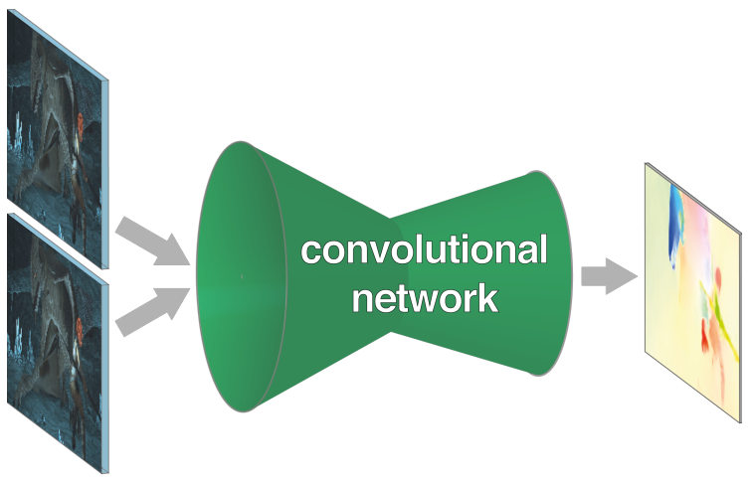
FlowNet

Slide 8
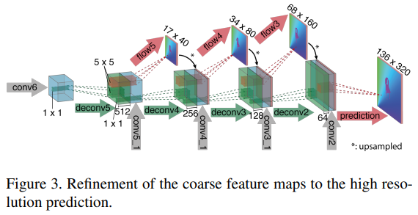
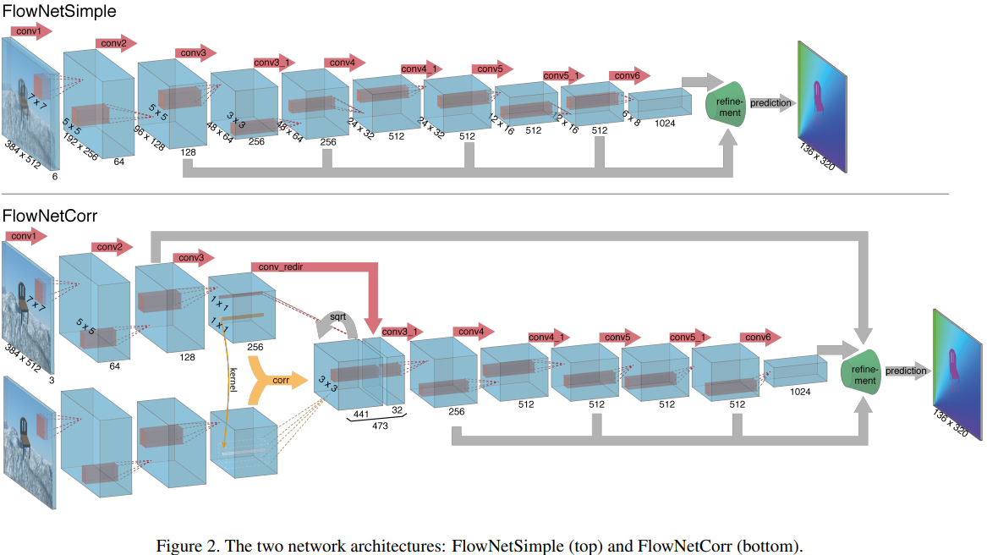
FlowNet

Slide 9
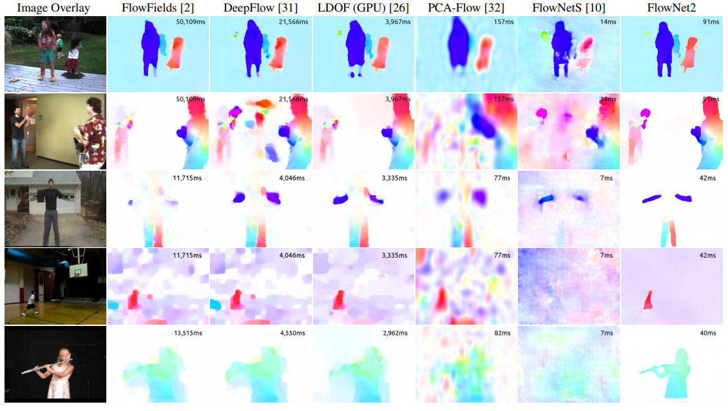
FlowNet

Slide 10
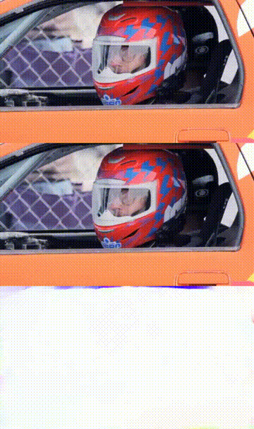
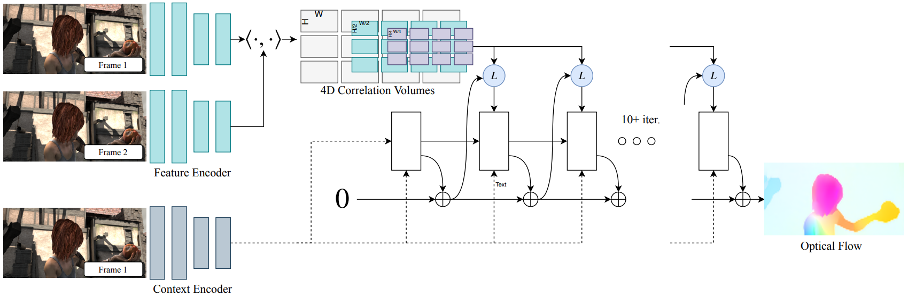
RAFT
Пример

Slide 11
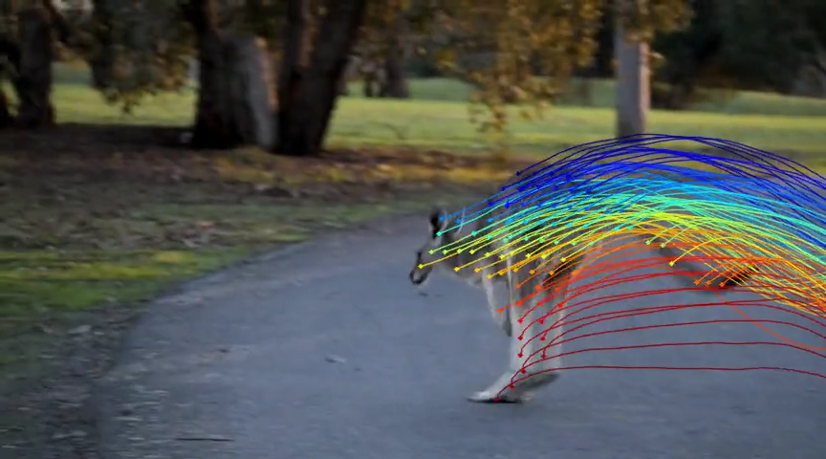
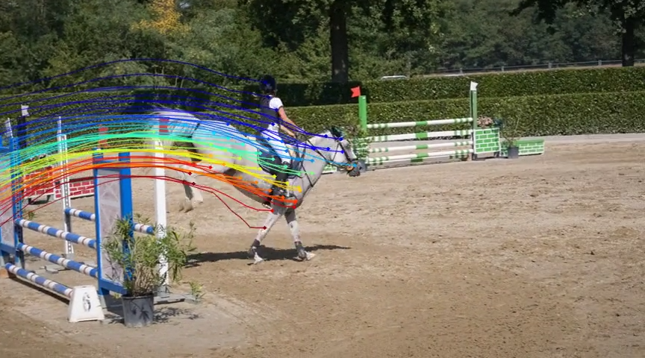
OmniMotion
https://omnimotion.github.io/

Slide 12
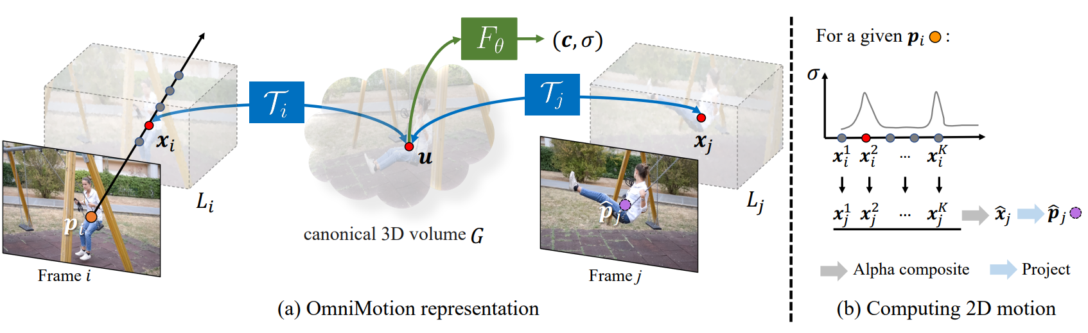
OmniMotion

Slide 13
Visual Object Tracking (VOT)
Template matching
Color-based tracking
Multi-domain network (MDNet tracker)
Generic Object Tracking Using Regression Networks (GOTURN)
Введение в VOT
Примеры методов VOT

Slide 14
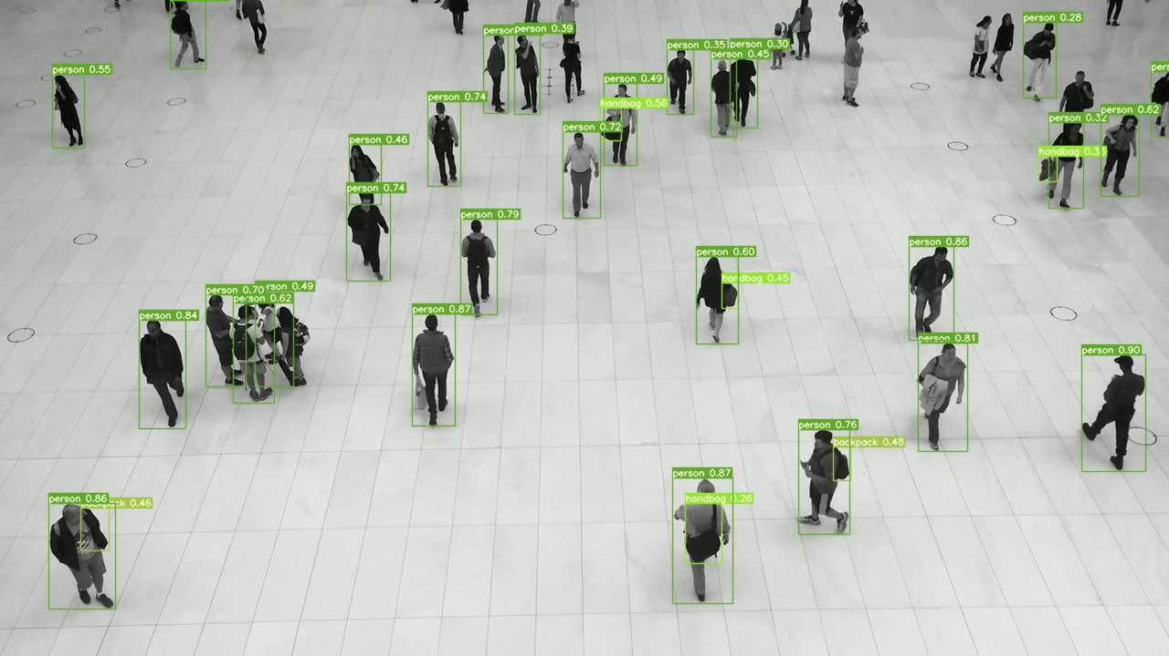
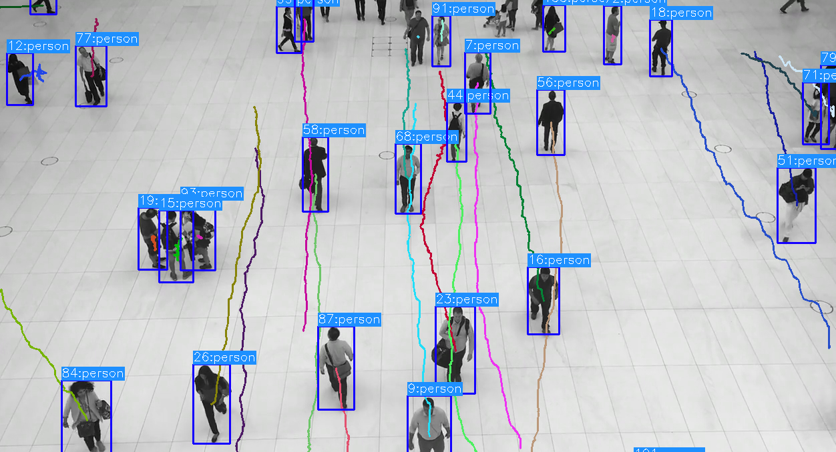
Multiple Object Tracking (MOT)
Detection
Tracking

Slide 15
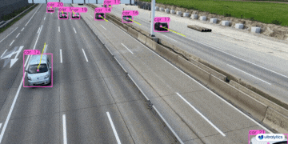
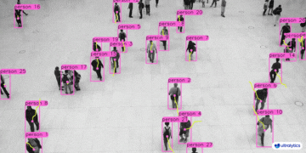
Multiple Object Tracking (MOT)

Slide 16
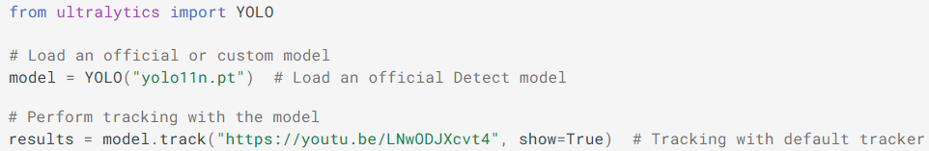

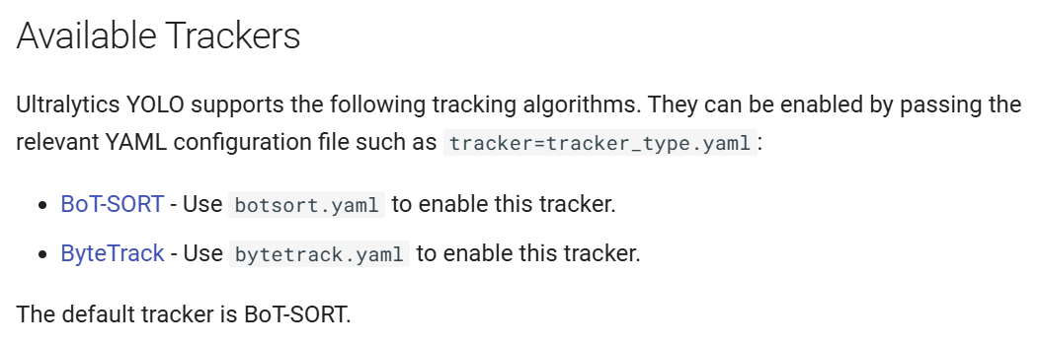
Multiple Object Tracking (MOT)
https://docs.ultralytics.com/modes/track/
https://github.com/ultralytics/ultralytics/tree/main/ultralytics/cfg/trackers

Slide 17
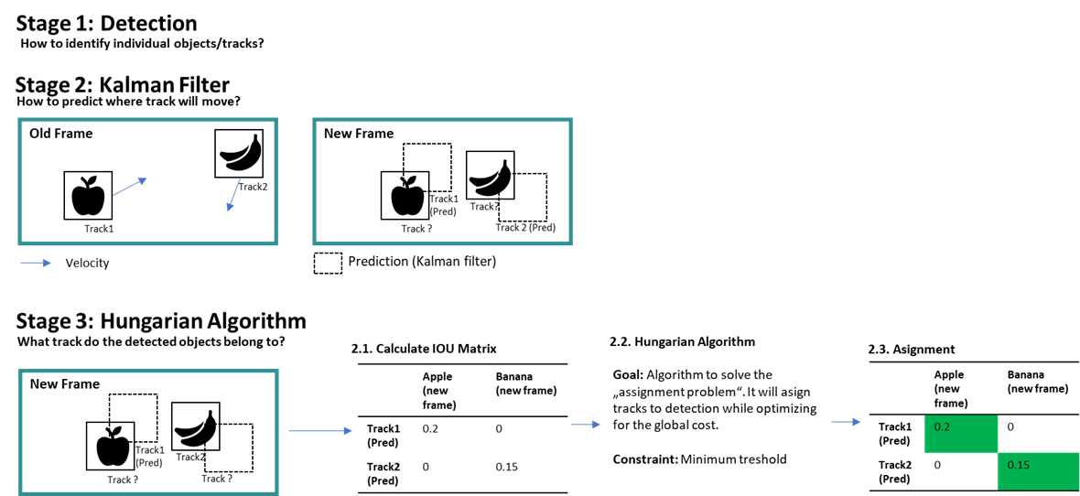
1. SORT (2016)
https://www.linkedin.com/pulse/object-tracking-sort-deepsort-daniel-pleus/

Slide 18
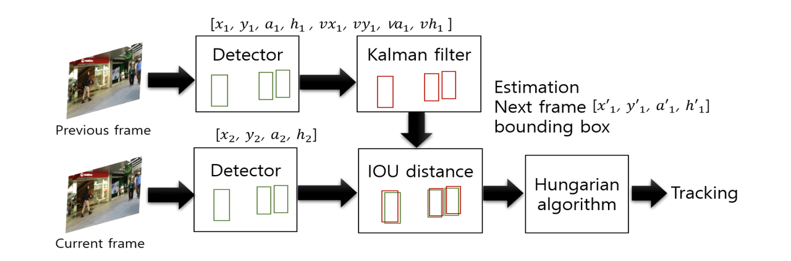
1. SORT (2016)

Slide 19
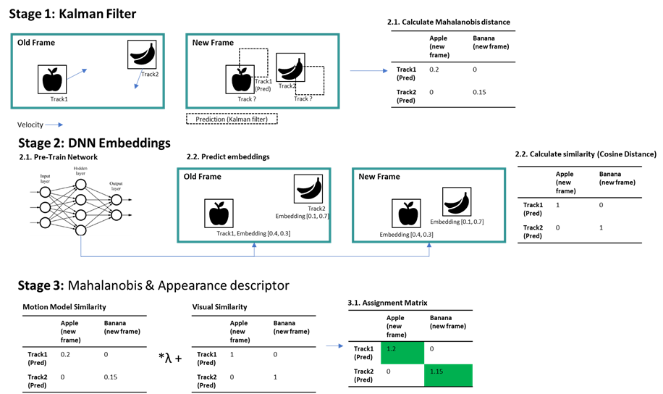
2. DeepSORT (2017)
https://www.linkedin.com/pulse/object-tracking-sort-deepsort-daniel-pleus/

Slide 20
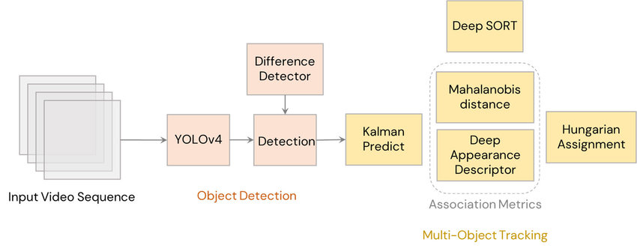
2. DeepSORT (2017)

Slide 21
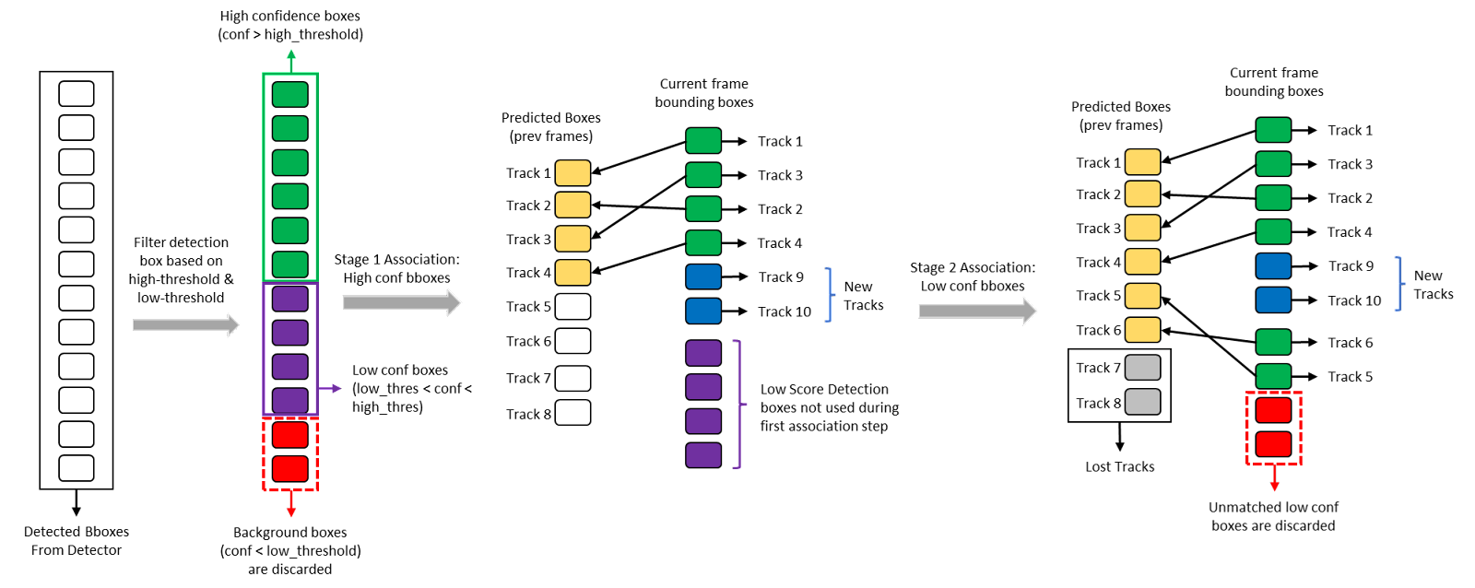
3. ByteTrack (2021)

Slide 22
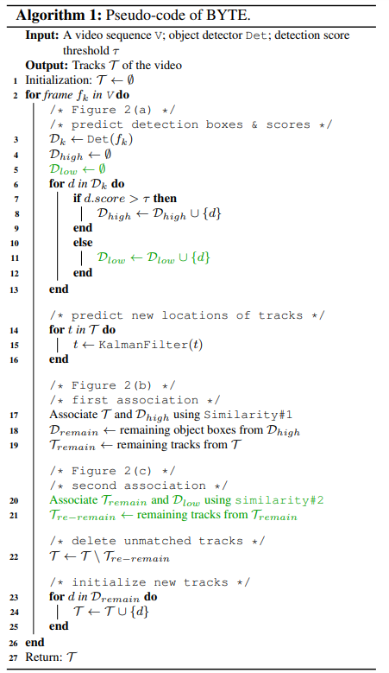
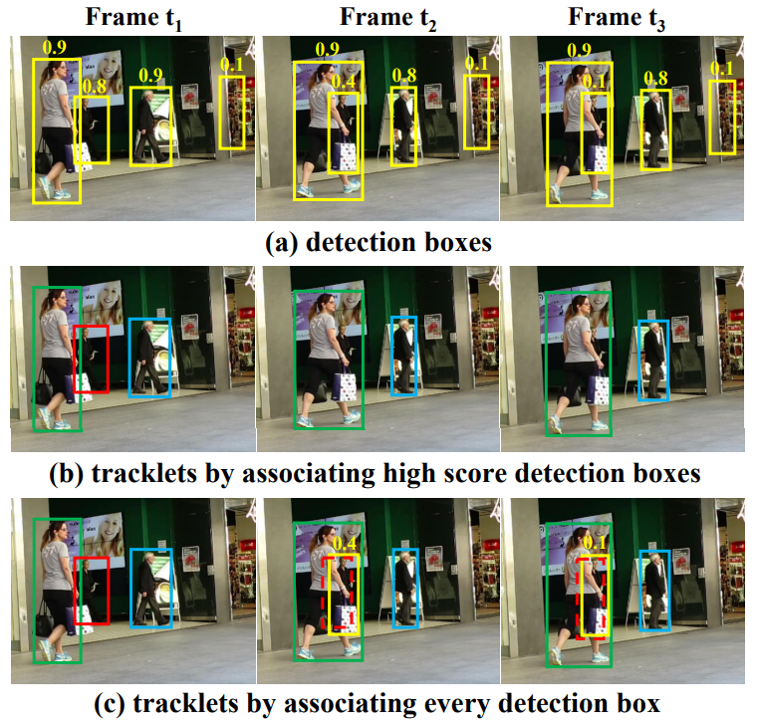
3. ByteTrack (2021)

Slide 23
4. BoT-SORT, BoT-SORT-ReID (2022)
«bag-of-tricks»

Slide 24
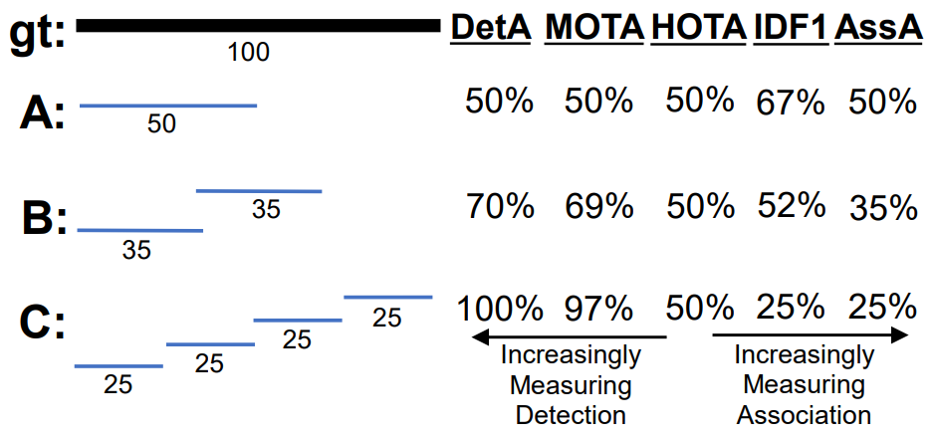
Object Tracking Metrics
DetA
MOTA
HOTA
IDF1
AssA
Хорошая статья о метриках трекинга

